Slide 1


FRAUD DETECTION IN BANKING TRANSACTIONS
17/01/2025
ANJANA C

Slide 2


TABLE OF CONTENT
01
Introduction
02
06
About Dataset
Model Training
03
Statistical Analysis
07
Hyperparameter Tuning
04
EDA
08
Model Deployment
05
Data Preprocessing

Slide 3

Problem statement :
Fraud transaction detection in banking transactions.
Why is it relevant ?
Fraud detection in banking protects customers, prevents financial losses, and ensures trust. It helps comply with regulations, safeguard data, and stop crimes like identity theft. Advanced tools like machine learning enable faster, more accurate detection. By detecting fraud early, banks secure operations and build confidence in the financial system.

Slide 4


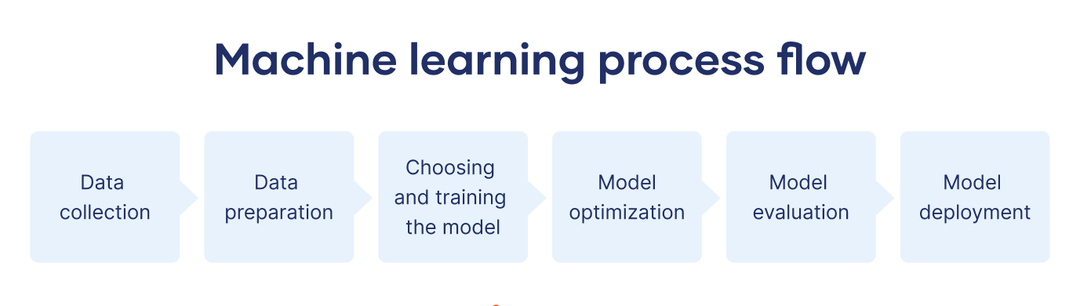
INTRODUCTION
This presentation explores the fraud detection dataset using statistical methods, exploratory data analysis, feature engineering, and machine learning models such as KNN Classifier, Decision Tree, Random Forest, XG Boost, LGBM . It includes insights, model evaluation, and key outcomes for fraud detection.
PROPOSED SYSTEM

Slide 5

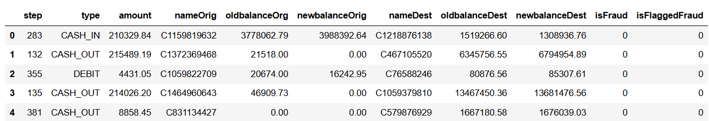
DATASET
Size of dataset: 6998882.
No.of rows: 636262
No.of columns: 11.

Slide 6

DATASET
Column Descriptions
step: maps a unit of time in the real world. In this case 1 step is 1 hour of time. Total steps 744 (30 days simulation).
type: CASH-IN, CASH-OUT, DEBIT, PAYMENT and TRANSFER.
amount: amount of the transaction in local currency.
nameOrig : customer who started the transaction
oldbalanceOrg : initial balance before the transaction
newbalanceOrig : new balance after the transaction
nameDest : customer who is the recipient of the transaction

Slide 7
oldbalanceDest : initial balance recipient before the transaction. Note that there is not information for customers that start with M (Merchants).
newbalanceDest: new balance recipient after the transaction. Note that there is not information for customers that start with M (Merchants).
isFraud: This is the transactions made by the fraudulent agents inside the simulation. In this specific dataset the fraudulent behavior of the agents aims to profit by taking control or customers accounts and try to empty the funds by transferring to another account and then cashing out of the system.
isFlaggedFraud: The business model aims to control massive transfers from one account to another and flags illegal attempts. An illegal attempt in this dataset is an attempt to transfer more than 200.000 in a single transaction.

Slide 8
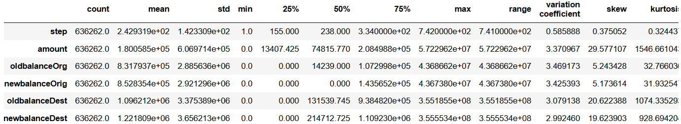
INSIGHTS FROM DESCRIPTIVE STATISTICS FOR NUMERICAL COLUMNS
Most variables exhibit significant skewness and kurtosis, indicating the presence of outliers and heavy-tailed distributions.
The wide ranges and high variation coefficients for financial variables ("Amount," "OldbalanceOrg," etc.) suggest the need for scaling or normalization before analysis.
The nearly symmetric distribution of "Step" makes it suitable for straightforward statistical methods.

Slide 9
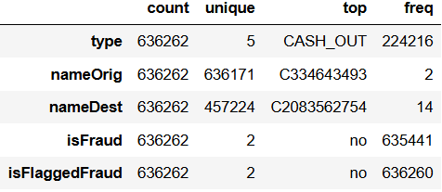
INSIGHTS FROM STATISTICAL FEATURES FOR CATEGORICAL COLUMNS
Type: The dominance of "CASH_OUT" suggests it may warrant closer inspection, especially for fraud patterns.
nameOrig/nameDest: Significant duplication in destination accounts (nameDest) might indicate repeated fraudulent activity or common endpoints for legitimate transactions.
isFraud: The dataset is heavily imbalanced, with fraudulent transactions comprising only a tiny fraction of the data.
isFlaggedFraud: Almost no transactions are flagged, raising questions about the criteria for flagging.

Slide 10
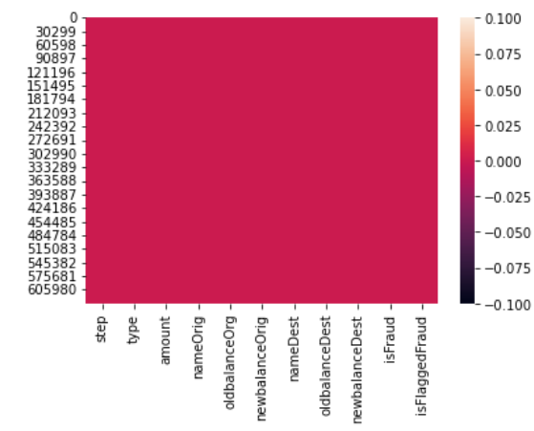
HEATMAP FOR CHECKING MISSING VALUES
No missing values found in the dataset.
No Duplicates present in the dataset.

Slide 11
DROPPING UNECESSAY COLUMNS
The isFlaggedFraud column is dropped.
The column is meant to flag all suspicious transactions having amount above 200k.
But the flag is true for only two columns even when there is 167033 transaction with amount above 200k.

Slide 12
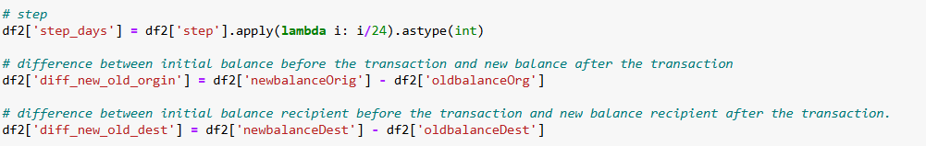
FEATURE ENGINEERING

Slide 13
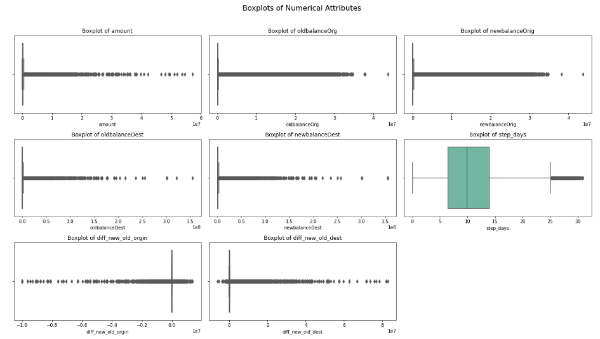
EXPLORATORY DATA ANALYSIS (EDA)
1. Univariate Analysis – Numerical Variables

Slide 14
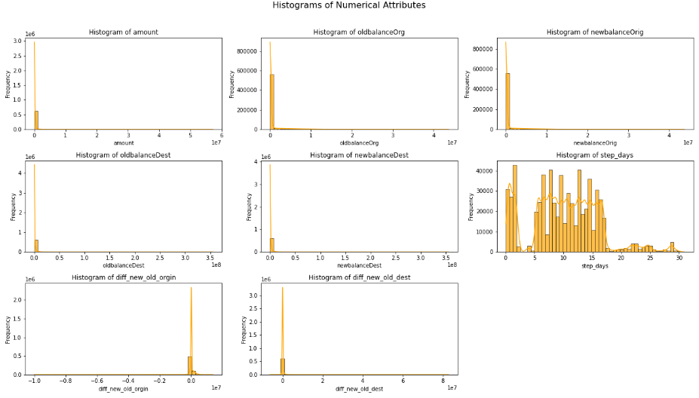

Slide 15
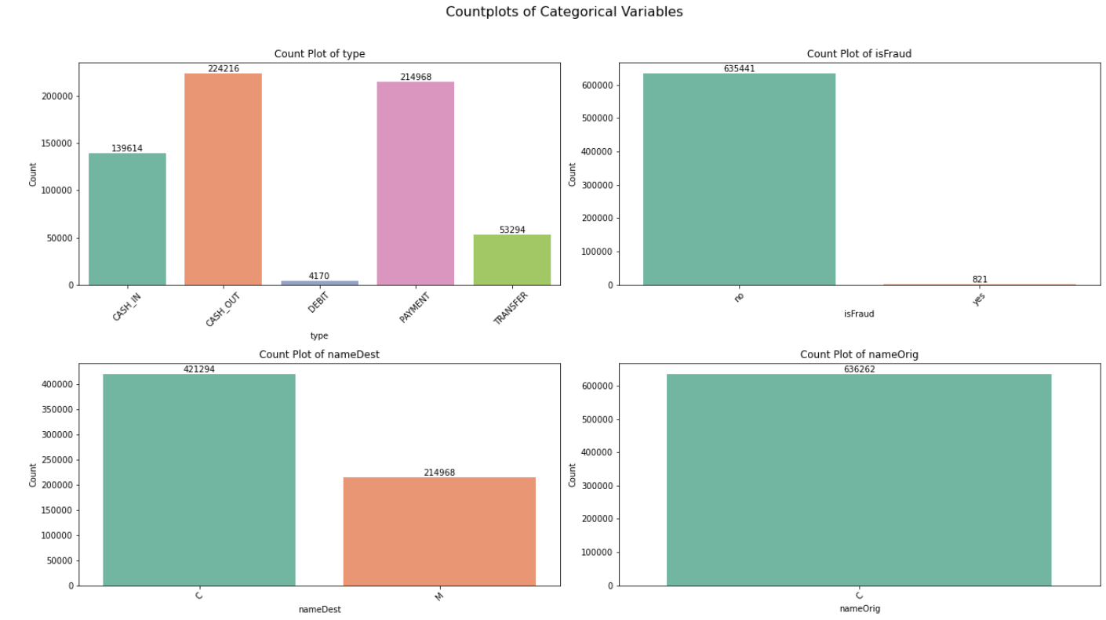

Slide 16
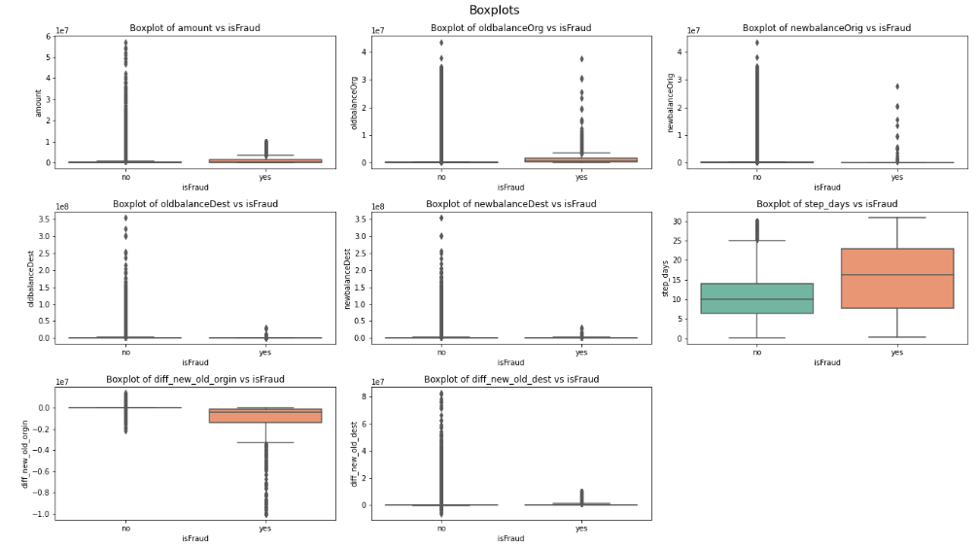
2. Bivariate Analysis

Slide 17
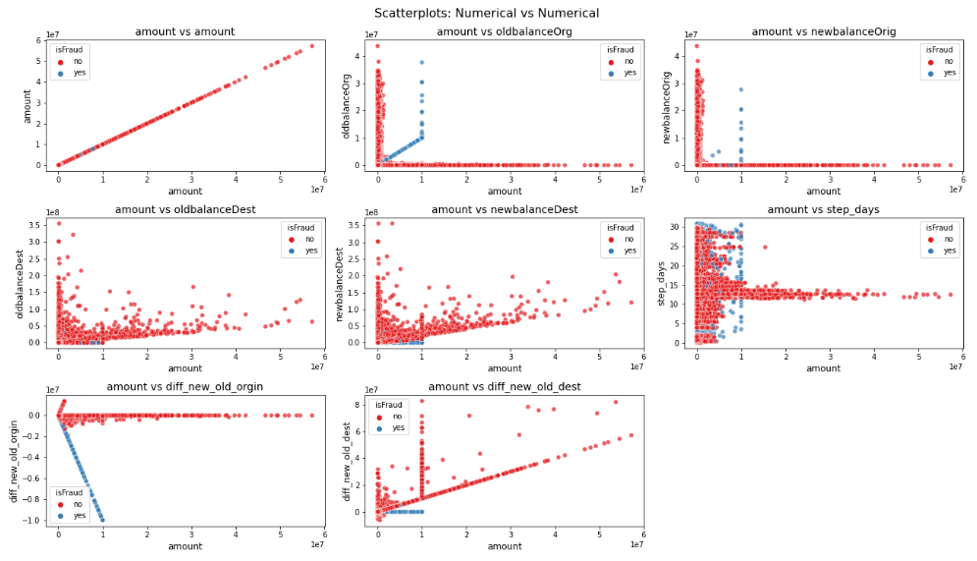

Slide 18
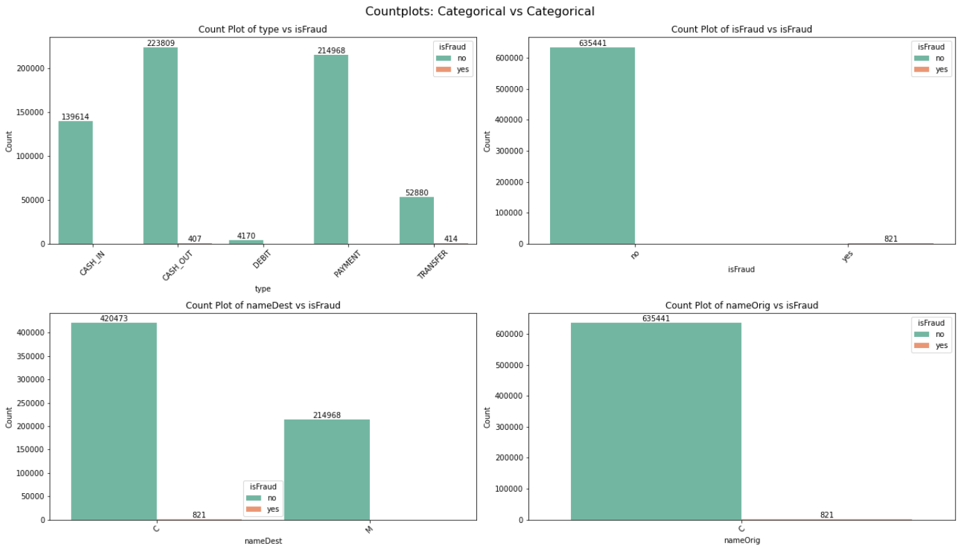

Slide 19
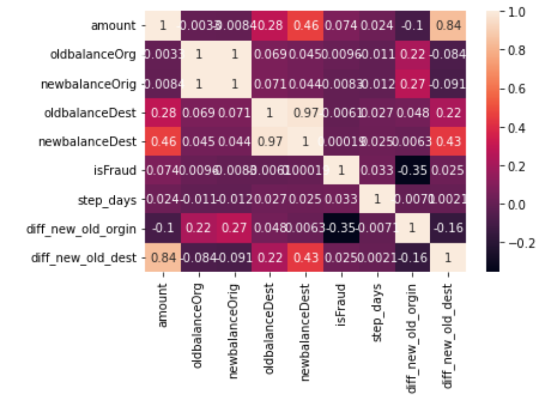
3.Multivariate Analysis
Heatmap

Slide 20
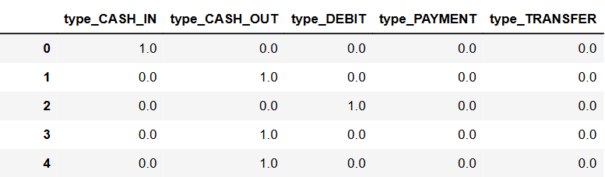
DATA PREPROCESSING
FEATURE ENCODING
Encoded categorical column “type” using One Hot Encoder.

Slide 21
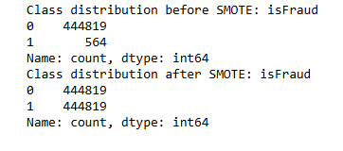
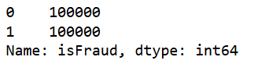
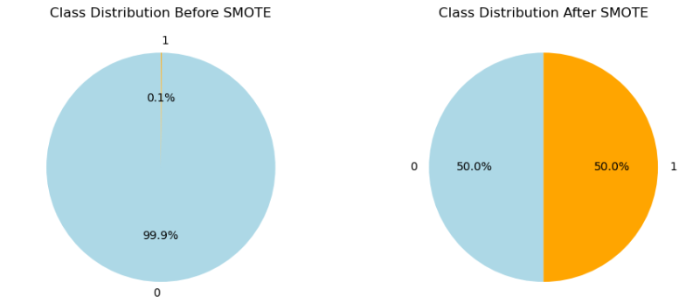
HANDLING DATA IMBALANCE USING SMOTE & UNDER SAMPLING

Slide 22
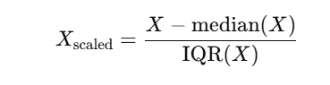
FEATURE SCALING
Robust Scaling
Robust scaling is a method of standardizing features by removing the median and scaling them according to the Interquartile Range (IQR).
Why we used Robust Scaling ?
Data with Outliers: If your dataset contains outliers, robust scaling is preferred because it uses the median and IQR, which are less affected by extreme values.

Slide 23
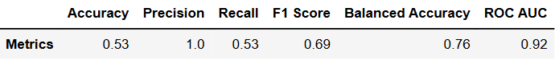
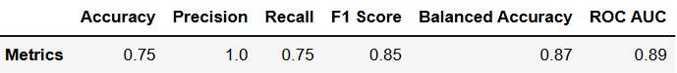
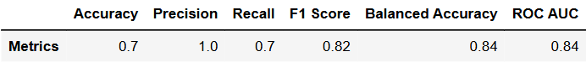
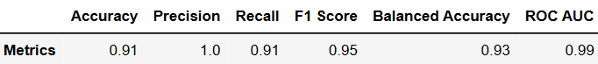
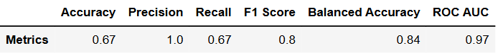
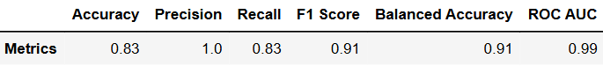
MODEL TRAINING RESULTS
MODEL | TRAINING METRICES
Logistic Regression
KNN Classifier
Decision Tree
Random Forest
XG Boost
Light GBM

Slide 24
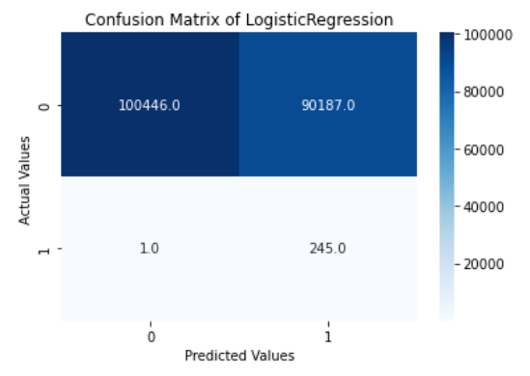
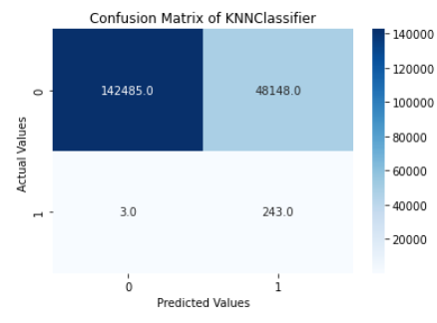
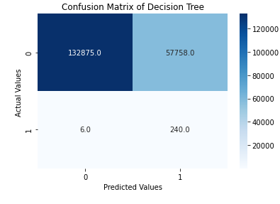
CONFUSION MATRIX OF DIFFERENT ALGORITHMS

Slide 25
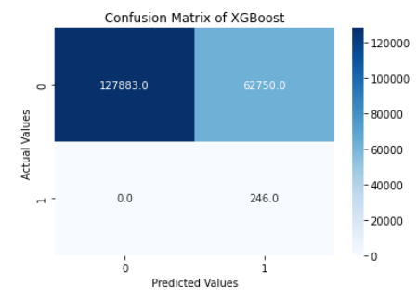
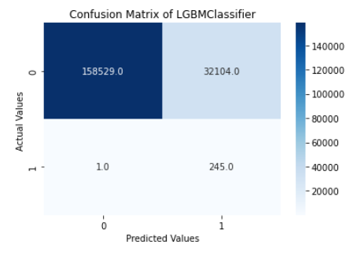
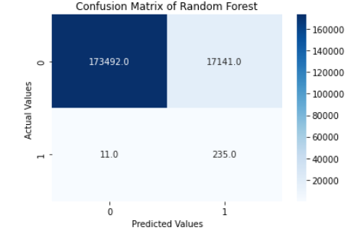

Slide 26
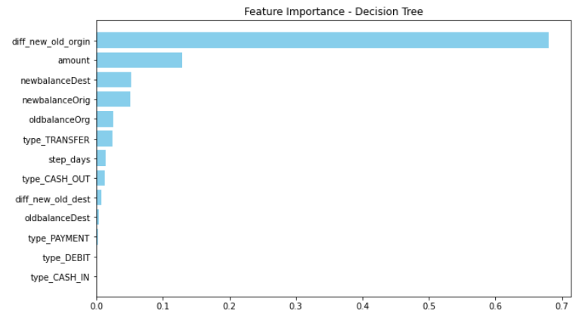
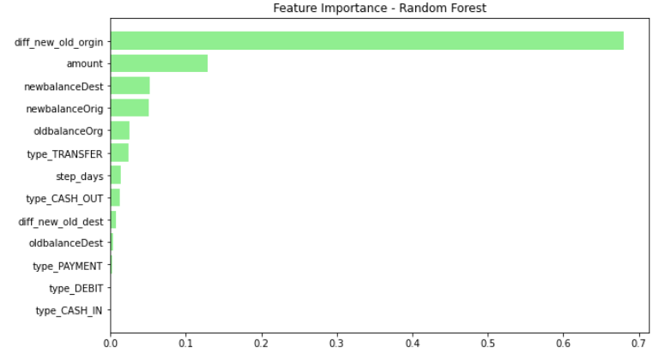
FEATURE IMPORTANCE

Slide 27
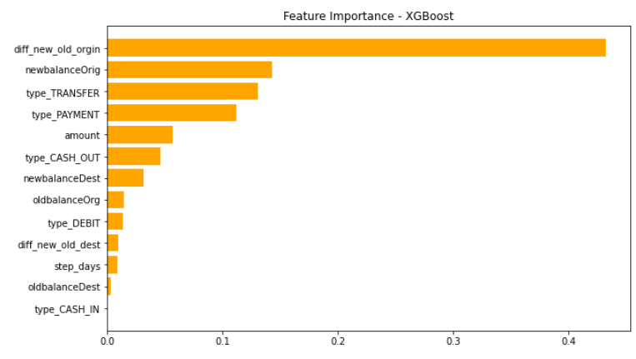
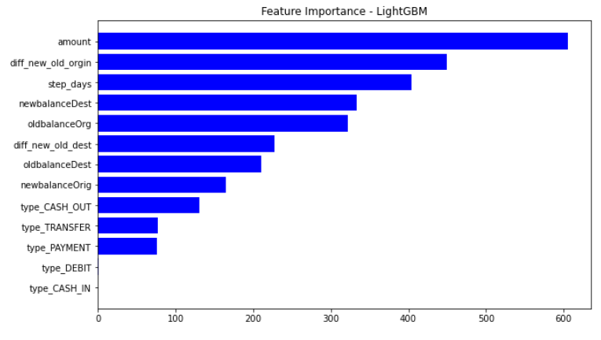

Slide 28
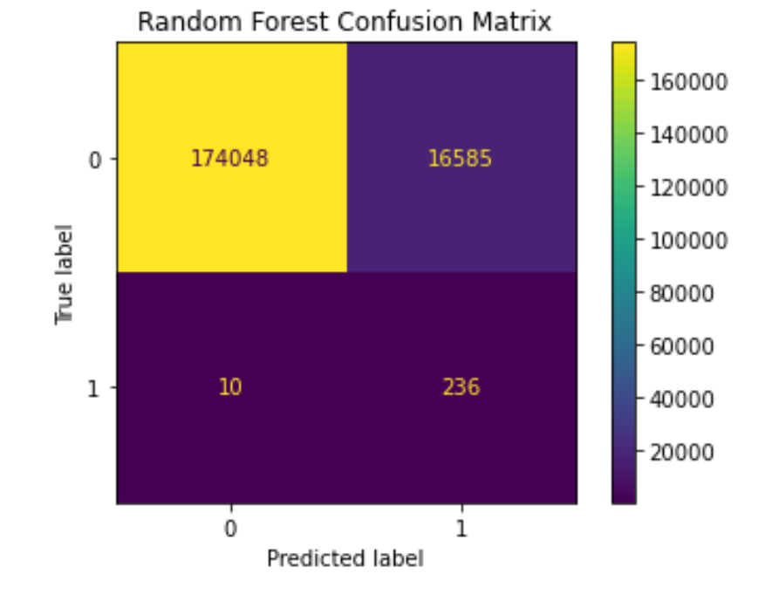
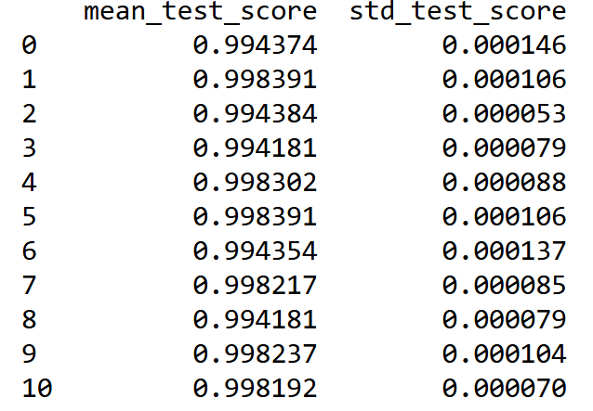
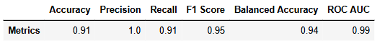
HYPERPARAMETER TUNING
Best Parameters
n_estimators: 200,
min_samples_split : 2
min_samples_leaf: 1
max_features: sqrt max_depth: 30
bootstrap: True
Cross Validation Results
Confusion Matrix

Slide 29
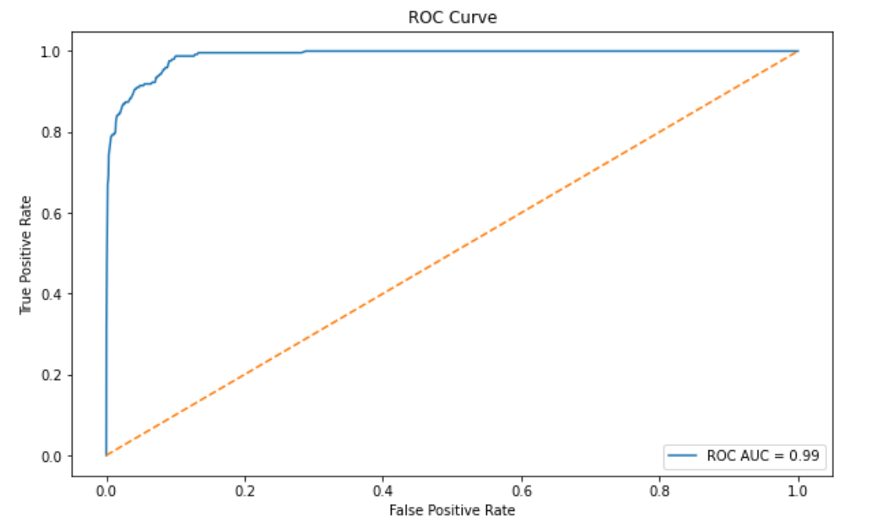
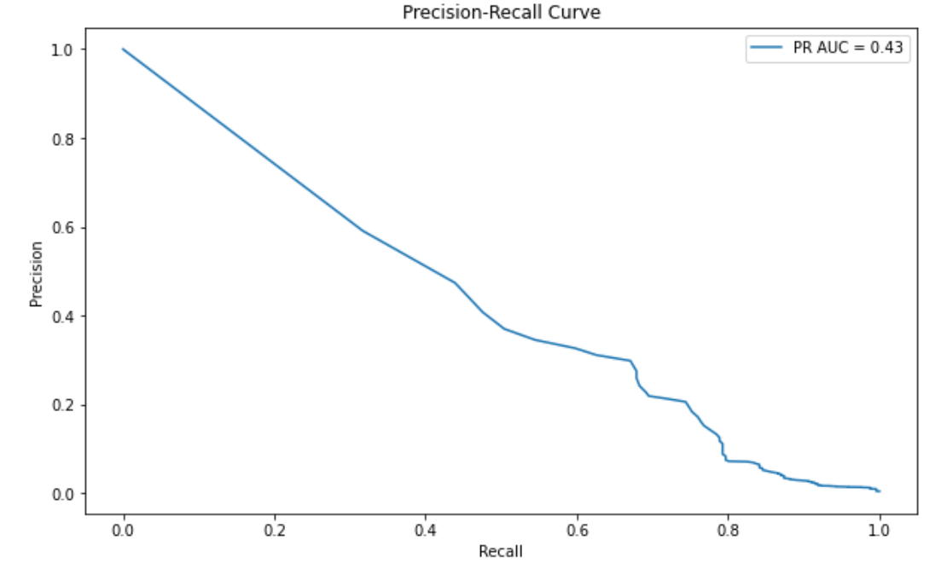

Slide 30
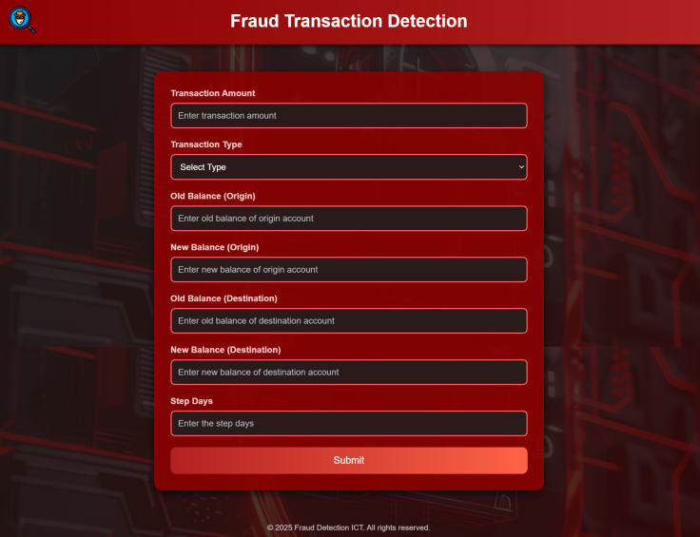


MODEL DEPLOYMENT
USING FLASK

Slide 31
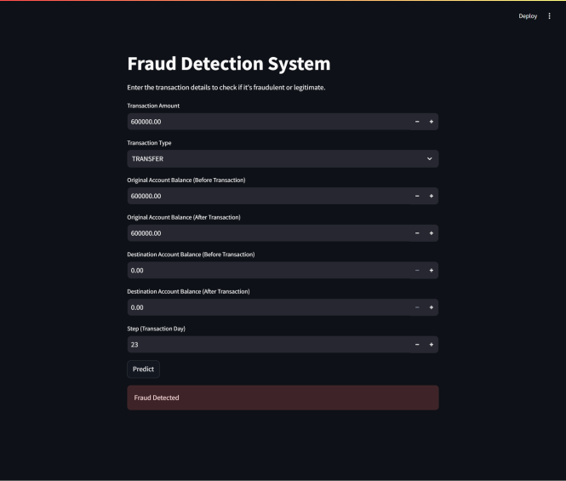
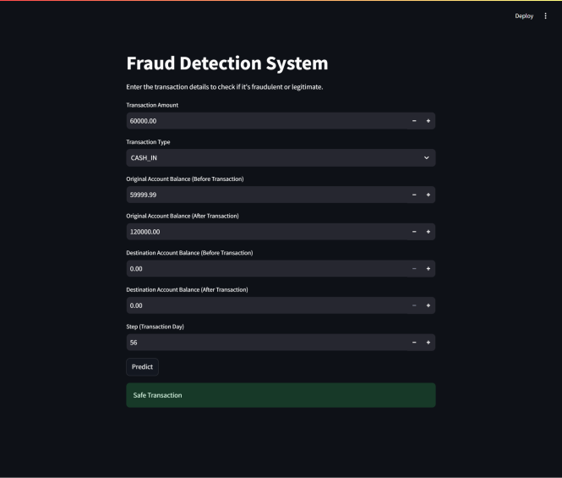
MODEL DEPLOYMENT
USING STREMLIT

Slide 32

THANK YOU…

